Slide 1
Treasurer’s report - 2022

Slide 2
Overall position

Slide 3
Spg funding
SEMESTER 1
SEMESTER 2

Slide 4
Base funding
SEMESTER 1
$2133
SEMESTER 2
$2090.63
Minus $3574.11 from unspent semester 1 SPGS
We ended up paying Guild ~$280
This was mainly due to the cancellation of Camp

Slide 5
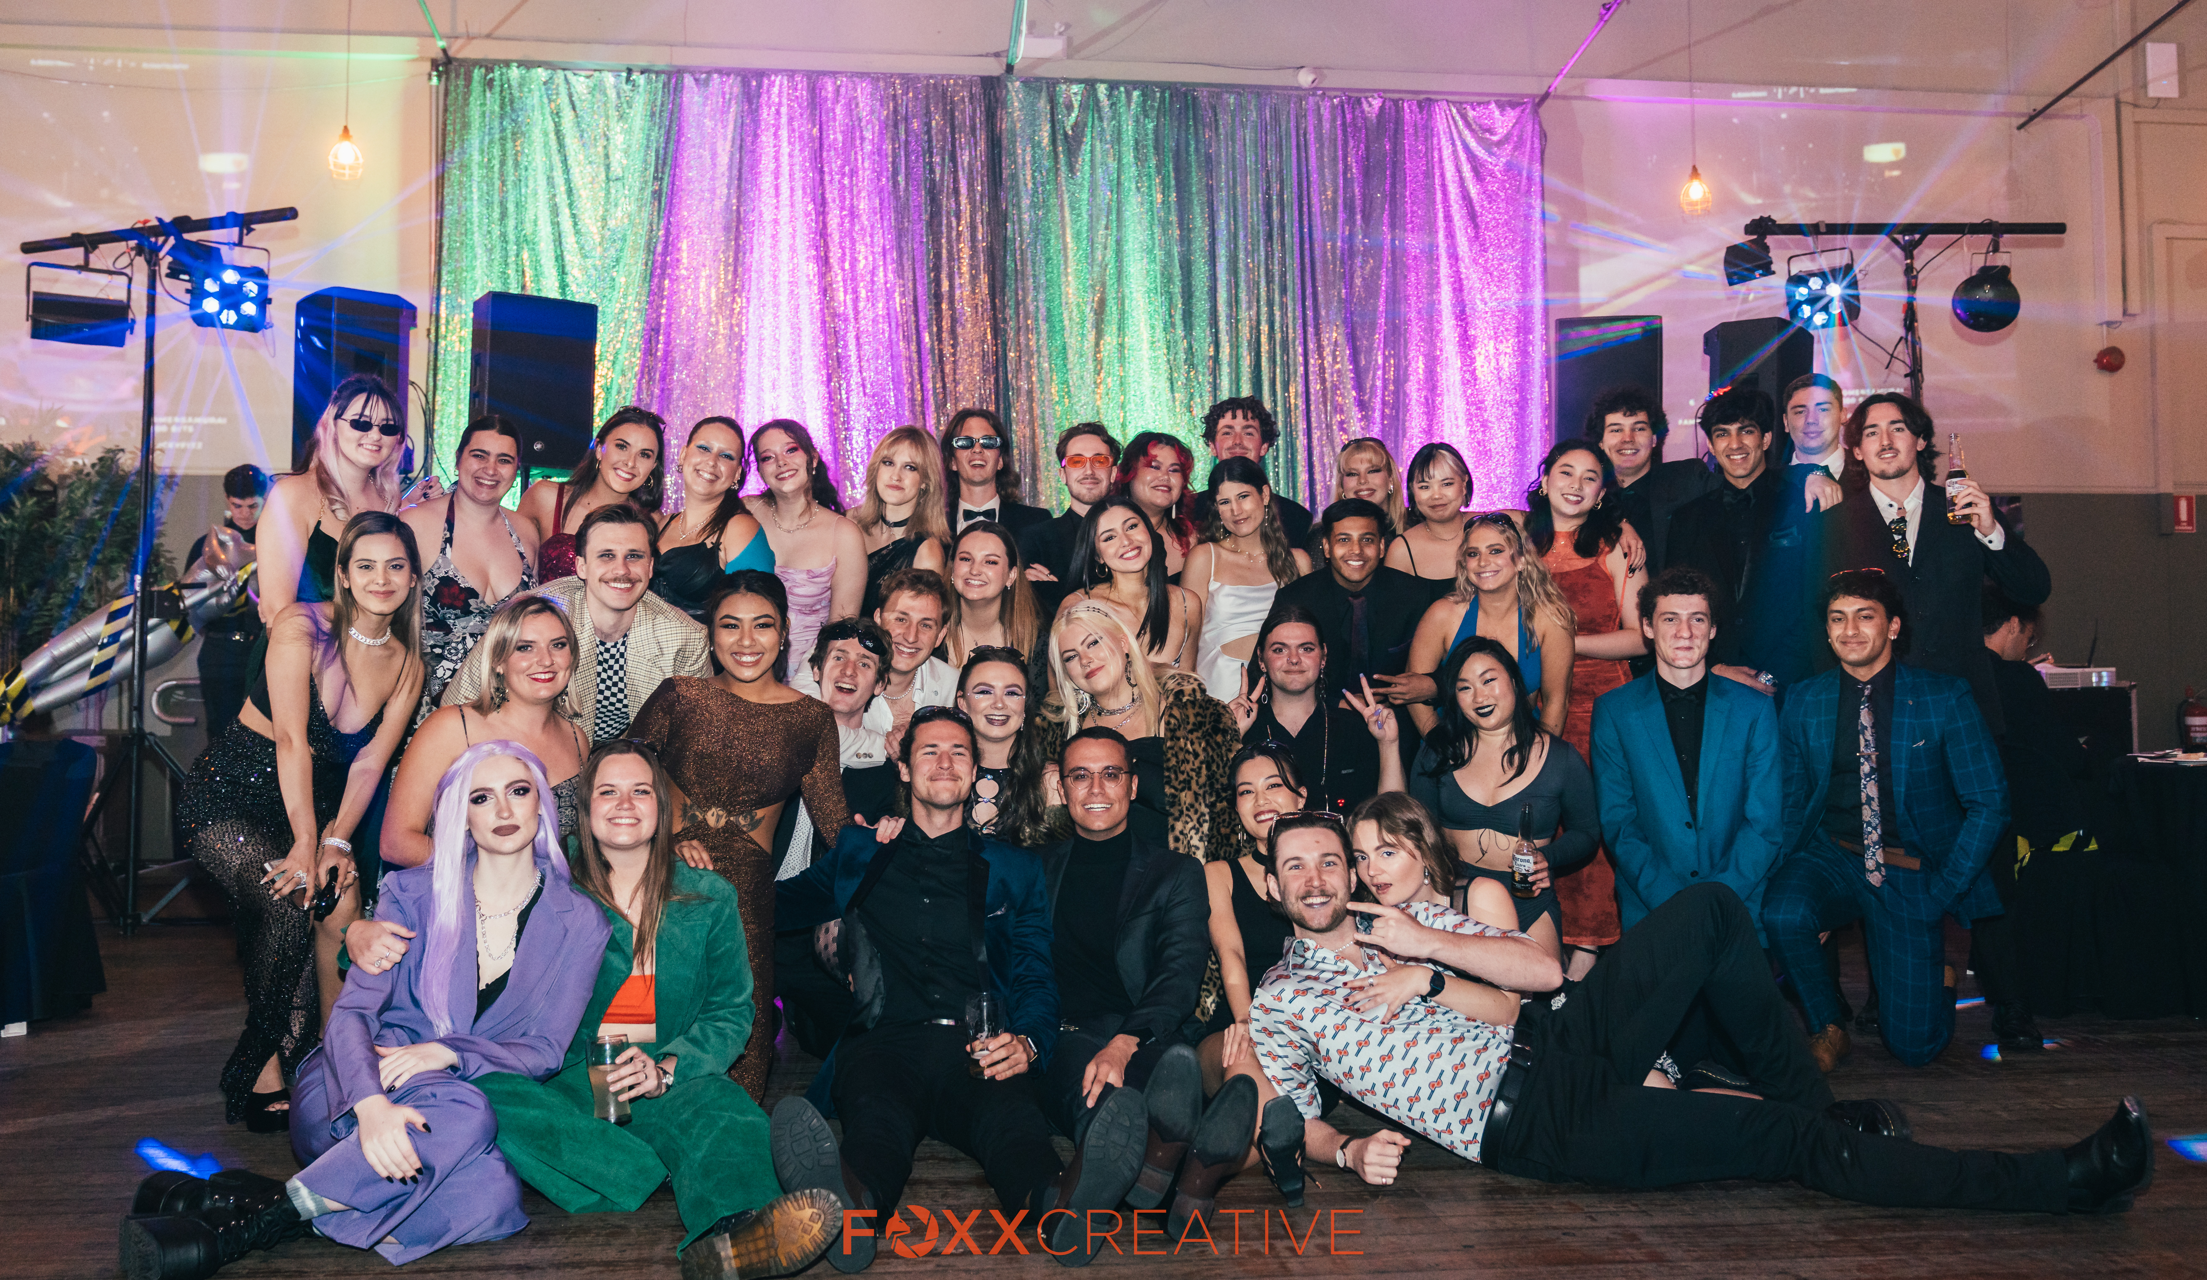
THANK YOU ALL FOR A WONDERFUL YEAR

